Slide 1
Lab 5 Presentation:
Fall Monitor
Zainab Rehan 100653955
Jay Patel 100658633
Ramin Sami 100655257

Slide 2
Introduction
The product is used to detect if a fall has occurred and to inform a support agent through a call if the client remains motionless or does not stand up for a set period of time.
The agent then takes the call and uses the client’s information and GPS coordinates supplied by the monitor to inform emergency officers that an emergency has occurred.

Slide 3
Product Description
The fall monitor will contain safety measures and emergency protocols that are required in case of a fall. The monitor will contain hardware that incorporates a motion sensor and a communication module via bluetooth.

Slide 4
Objectives
Secure login and registration. Keeps personal information safe
A clear and understandable website that both new and old users can easily use
Device should detect if a fall has occurred with the use of a motion sensor.
Device should alert safety officers in the event of a fall, provided that the client does not get up after a specified time or remains motionless for a set period of time, such as 15-20 seconds.

Slide 5
Objectives
Device should successfully send client’s information and GPS coordinates to the safety officers.
Devices must be able to make a call at any geographical location without interruptions caused by network issues.
Website and device must be user friendly, in terms of information and activation steps.

Slide 6
Measures of Success
Reduction in fall-related deaths of elderly and disabled people in Canada.
Reduction in response time from officers thus reducing severe injuries and getting clients the help they need faster.
Device is able to make a successful call regardless of geographical location and network issues

Slide 7
Measures of Success
The device keeps track of how fast the client falls in order to call the safety officer.
Project actual cost should not exceed estimated and approved budget developed by the team
The product must raise awareness towards the importance of ensuring the well being of seniors and people with disability
The project must be efficiently developed in terms of cost in order to be sold to the market for free.

Slide 8
Risk 1: Inaccurate Budget Estimation
During the estimation process any mistake can result in a major budget shift. Estimation team must be very thorough with the requirements. Lack of awareness of the requirements and human errors can cause issues in budget estimation.
Cost estimation will be emphasized by running a strict recruitment process for the position. Planning is kept transparent with the budget estimation team. The team will be instructed to plan for various scenarios and an end of the stage meeting will be hosted with the stakeholders to review the budget estimations

Slide 9
Risk 2: Lack of/Improper Training
Employees might not feel ready to do their job at the end of the training. This lack of training can lead to mistakes and errors occurring while doing a task, and depending on the importance of the task, it can lead to the delay of the overall product.
To avoid this issue the team would prepare required training material for the employees. We would like to offer mandatory training sessions for the employees. An end of training evaluation will be conducted to assess the employees on the knowledge and skills they learnt from the training

Slide 10
Risk 3: Poor Quality Testing
Errors might get overlooked during the testing phase. These errors can lead to the shutdown of the product, or injury to the client if not dealt in an efficient manner.
The team will make sure the testing phases are not rushed and every bug/error has been accounted for. Progress reports will be incorporated to keep track of testing. Stakeholders will review the tested product for any minor tweaks. Our planning allows enough time for the testing phase to not become a pressured and hasty process.

Slide 11
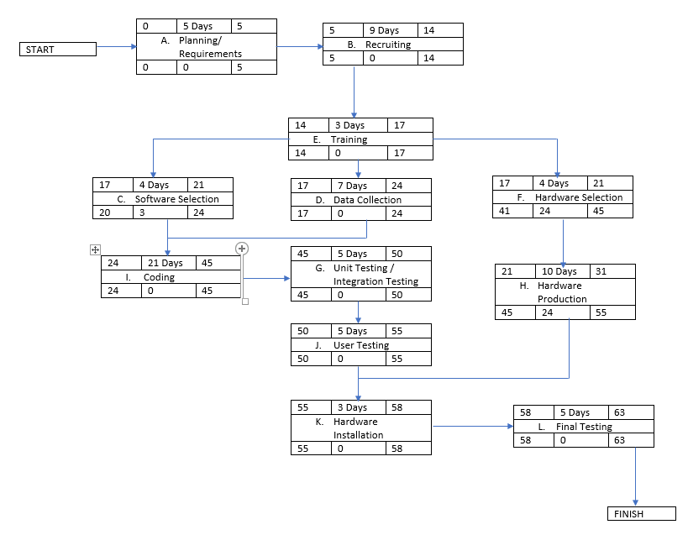
Activity Diagram
Notes:
No holiday and weekends are included in the activity diagram. All of the working days come around to be 63 days in total.

Slide 12
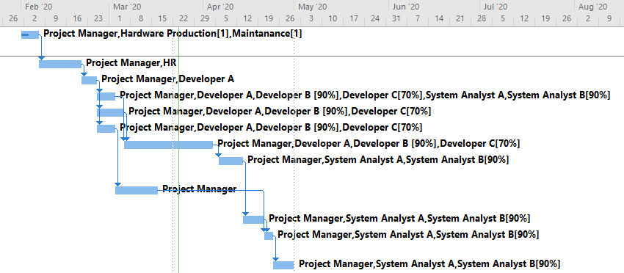
Gantt Chart

Slide 13
Thanks!
Any Questions?

